Slide 1
Dynamically Duplicate Input Elements

Slide 2
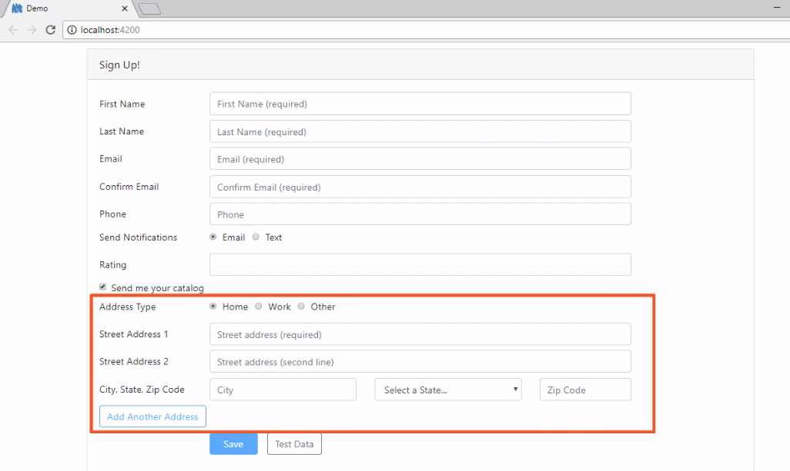

Slide 3

Module Overview
Steps
Perform Each Step
- FormArrays

Slide 4
Steps to Dynamically Duplicate Input Elements
Duplicate the input element(s)
Loop through the FormArray
Create a FormArray
Refactor to make copies
Define a FormGroup, if needed
Define the input element(s) to duplicate

Slide 5
Steps to Dynamically Duplicate Input Elements
Duplicate the input element(s)
Loop through the FormArray
Create a FormArray
Refactor to make copies
Define a FormGroup, if needed
Define the input element(s) to duplicate

Slide 6
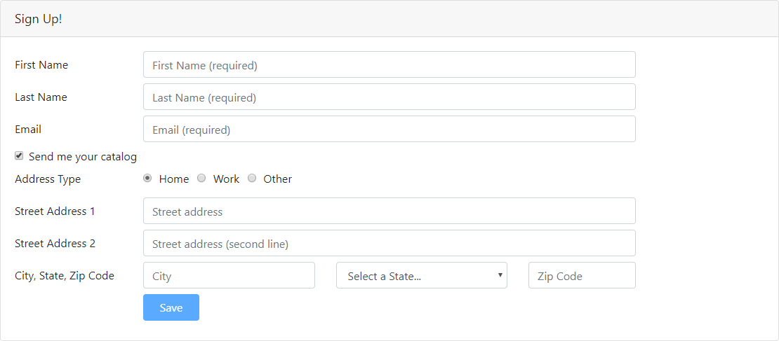

Slide 7
Steps to Dynamically Duplicate Input Elements
Duplicate the input element(s)
Loop through the FormArray
Create a FormArray
Refactor to make copies
Define a FormGroup, if needed
Define the input element(s) to duplicate

Slide 8
FormGroup
FormGroup
FormControl
FormControl
FormGroup
FormControl
FormControl
FormGroup
FormControl
FormGroup
FormControl
FormControl

Slide 9
Benefits of a FormGroup
Match the value of the form model to the data model
Check touched, dirty, and valid state
Watch for changes and react
Perform cross field validation
Dynamically duplicate the group

Slide 10
Steps to Dynamically Duplicate Input Elements
Duplicate the input element(s)
Loop through the FormArray
Create a FormArray
Refactor to make copies
Define a FormGroup, if needed
Define the input element(s) to duplicate

Slide 11
Creating a FormGroup in a Method
buildAddress(): FormGroup { return this.fb.group({
addressType: 'home', street1: '',
street2: '',
city: '',
state: '',
zip: ''
});
}
this.customerForm = this.fb.group({
...
addresses: this.buildAddress()
});

Slide 12
Steps to Dynamically Duplicate Input Elements
Duplicate the input element(s)
Loop through the FormArray
Create a FormArray
Refactor to make copies
Define a FormGroup, if needed
Define the input element(s) to duplicate

Slide 13
FormArray
FormArray
FormArray
FormControl
FormGroup
FormControl
FormControl
FormControl
FormGroup
FormGroup
FormControl
FormControl
FormControl
FormControl
FormGroup
FormGroup
FormControl
FormControl
FormControl
FormControl
FormControl

Slide 14
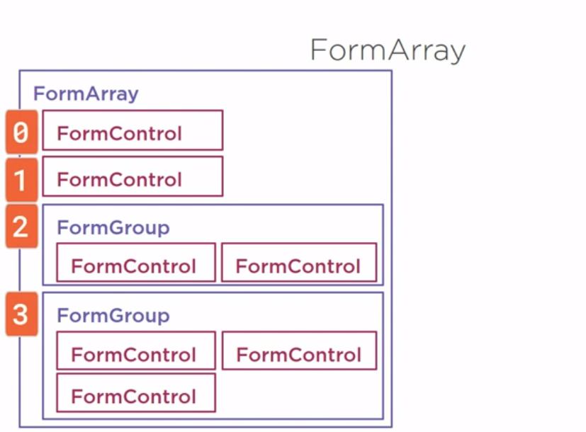

Slide 15
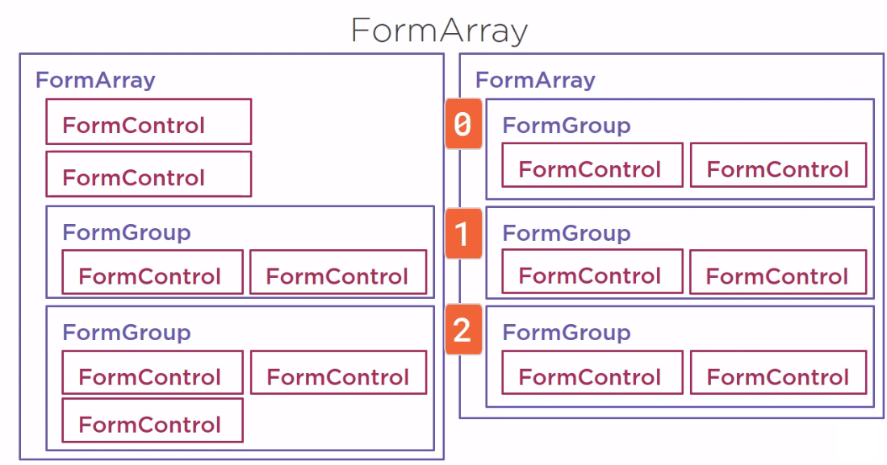

Slide 16
Creating a FormArray
this.myArray = new FormArray([...]);
this.myArray = this.fb.array([...]);

Slide 17
Steps to Dynamically Duplicate Input Elements
Duplicate the input element(s)
Loop through the FormArray
Create a FormArray
Refactor to make copies
Define a FormGroup, if needed
Define the input element(s) to duplicate

Slide 18
Looping Through a FormArray
<div formArrayName="addresses"
*ngFor="let address of addresses.controls; let i=index">
<div [formGroupName]="i">
...
</div>
</div>

Slide 19
Steps to Dynamically Duplicate Input Elements
Duplicate the input element(s)
Loop through the FormArray
Create a FormArray
Refactor to make copies
Define a FormGroup, if needed
Define the input element(s) to duplicate

Slide 20
Duplicate the Input Elements
addAddress(): void { this.addresses.push(this.buildAddress());
}
<button class="btn btn-primary" type="button" (click)="addAddress()">
Add Another Address
</button>

Slide 21
Checklist: Dynamically Duplicate Input Elements
Duplicate the input element(s)
Loop through the FormArray
Create a FormArray
Refactor to make copies
Define a FormGroup, if needed
Define the input element(s) to duplicate

Slide 22
Summary
Steps
Perform Each Step
- FormArrays

